Slide 1
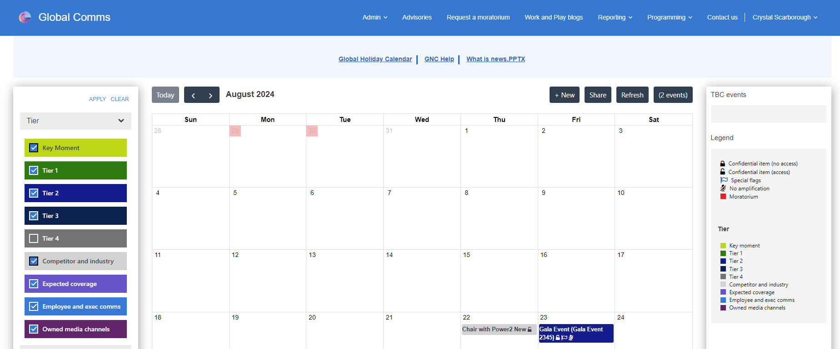
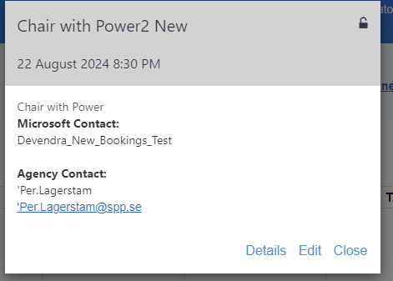
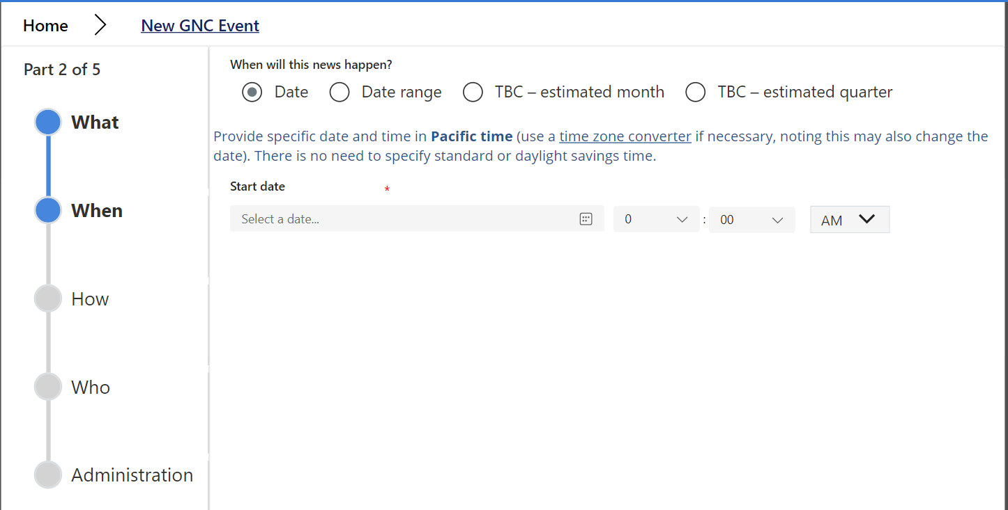
Microsoft PR HQ Power Pages Portal
Engagement Overview​
We engaged with Microsoft PR HQ to enhance their Global News Communications system into a one-stop shop improving user experience for finding global news entries and other communication information.
Consulting, planning, and executing a Power Pages Portal hosting a PowerApps application including Global News calendar, forms, Advisory listing and much more.
Updated their current SPFx solution on portal pages using Liquid coding. The idea was to keep the functionality the same with a few enhancements.
Taking a manual process for publication verification to their Frequent Fliers (including news outlets and influencers) to the next level with automation!

